Slide 1
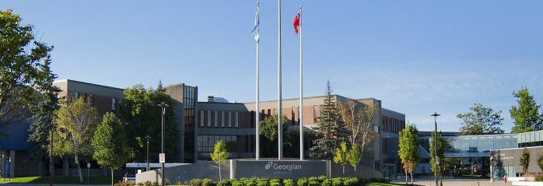
Major Research Projects
Artificial Intelligence (AIDI)
Ross Bigelow, Program Coordinator

Slide 2


XpertVR（难，试错成本太高，但感觉系统化很强，会很长见识，但都是接口开发，不太具有通用性）
Conversational AI for VR 对话情境AI（审讯、欺骗和冲突升级），将自己的模型成果集成到公司的平台上，实现更真实的虚拟现实的人机交互
The goal of this project is to build a conversation situations AI that will be used in different life scenario as Interrogation, Canvassing, and conflict de-escalation. Students will investigate different natural language generation models such as GPT for integration into XpertVR‘s VR simulation application. This project will allow XpertVR to build richer immersive experiences for their users that emulate more realistic human interaction with their nonplayer characters for a variety of teaching and training simulations（这家公司的系统应该挺让人长见识的，但成功的可能性不高）
Conversation situations where AI could be used:
Interrogation
I. Interview victim
II. Confession from Murderer/assailant
III. Confession from Thief
IV. Information from Witness
V. Information from Accomplice
Canvassing
I. Talking to neighbours after a crime occurred next door
II. Speaking to nearby business owners
III. Speaking to pawn shop employees about stolen property
IV. Speaking to landlord about cameras
Conflict De-escalation
I. Parent-Child Dispute
II. Partner-Partner Dispute
III. Roommate Dispute
IV. Sibling Dispute
V. Mental health episode
Features:
About me/persona card a.Fill out basic information (name, location, job, background related to situation, family, starting emotion, etc)（填写基本信息）
NPC emotions/emotion levels (anger/trust/etc) a. Emotions change based on conversation b. NPC respond differently depending on emotion（NPC根据情绪做出不同反应）
Cooperation with authority a. Need to dig for information depending on NPC’s level of trust with authority（根据 NPC 对玩家的信任度，生成不同的反应）
NPC responding to/interacting with other NPC’s in scenario a. Player is police officer and is talking to couple/parent-child/roommates/etc（NPC 之间的互动）
Animations tied to response a. NPC lunges at you as emotions increase b. NPC starts pacing when they’re nervous（触发动画：NPC 攻击（扑向玩家），NPC紧张（踱步））
Reaction based on player interaction with 3D objects in the scene a. Opens drawer with drugs in it b. Finds weapon c. Presents photos in interrogation d. Reaction to cameras (player taking photos)（识别玩家动作，NPC 做出反应，比如 a.玩家交易，a. NPC 拿出毒品，b. 找武器，c. 审讯，d. 玩家拍照，NPC 摆 pose）
Combination of XpertVR’s conversation matrix tool (Unity conversation tree creation tool) with AI a. Possibly having list of premade answers/conversations and then AI handles parts/questions that go beyond premade
How to decrease lag through having portions of AI hosted locally
https://xpertvr.ca/

Slide 3

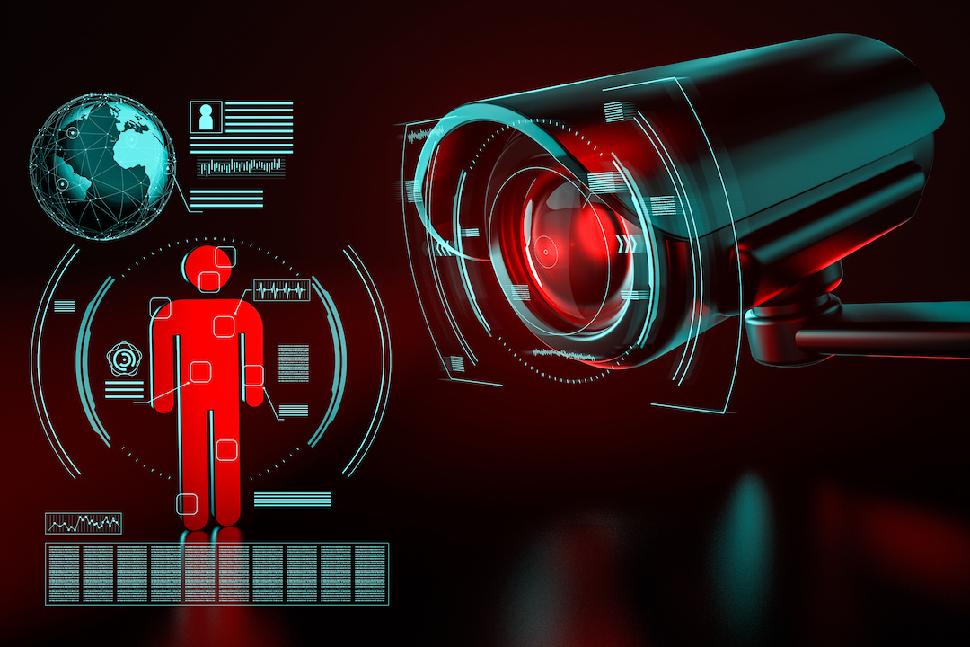
Georgian College
CRI - AI Cameras
Study the list of following thermal cameras and investigate about potential use as connects the camera, to the Covid passport, to the ID we have to show so that verification can be done. （将热像仪连接到新冠肺炎护照，或其他身份 ID 上）
PRT-1217B6PA-TWBB Provix Hikvision Dual Lens Turret Temperature Detect Camera, tripod, wireless
PRT-7MFTD-PC20 Provix Forehead Temperature Detection, Facial Recognition Terminal, 7 inch, Portable, 20AH Battery
Project Description

Slide 4

NURO Corp（要求 ms 性能，脑电波提取特征困难）
NURO | Machine Learning for Brain Computer Interface
The goal of this project will be to collect, analyze and generate successful Machine Learning Models in Google GCP for specific determination and continuous processing of neurological patterns by AI.
Objective 1: Several (numerical / anonymized) neurological datasets from various students will be wirelessly collected non-invasively from their prefrontal cortex (frontal part of the human head) while these students complete specific tasks. 取学生脑电波，识别神经信号的特定趋势
Objective 2: From these datasets, Machine Learning Models will have to be generated in Google Cloud Platform to identify specific trends within these neurological signals. 生成特征后送到 google 学习平台训练模型，识别神经信号的趋势
Objective 3: It would be interesting for NURO to have a sub-second notification engine from the best developed Machine Learning Model streaming an alert into an Android application using the Google Cloud Platform ecosystem. 能拥有一个响应快速的亚秒级系统就过关了
Project Description
Requirements
The students must be in Ontario to facilitate data collection and processing.
The students must use the Google GCP ecosystem.
The students and the school may need to sign a NDA for some of this work, if at all possible.
https://nuro.ca/

Slide 5

Skinopathy（CNN，难）
SkinAI
Skinopathy is a Toronto-based medical startup developing high performance healthcare through data and artificial intelligence. Our goal is to not only provide greater access to care, but to also improve healthcare outcomes in general.
Company Profile Video: https://www.youtube.com/watch?v=6PiTCMPTQIM
The project is to develop three distinct components of the SkinAI platform. The first is related to developing and training a CNN-based image classifier for dermatological diseases. 用 CNN 给皮肤病图片分类
The second is to conduct unsupervised learning on data residing in the Skinopathy’s EMRs (Electronic Medical Record) systems. 对公司电子病历进行无监督学习分类
The third component is also related to the EMR; it is to design and build a recommender system to make the physician’s task work will be done in Python using Colab Notebooks.
Project Description
Requirements
Deliverables
We will be using Google Colab and Google Drive primarily
Most coding will be done in Python, including the Tensorflow-Keras framework
Ability to Flask codes for serving to the App or EMR is a required
Familiarity using Jira boards for work tracking
Signing an NDA for IP and handling Patient health Information
Image Datasets in google Drive folders and accompanying csv files
EDA report for dermatological datasets 皮肤科数据集的数据探索
Model codes in Colab Notebooks
Data visualizations for latent inference
Model Performance Reports
https://skinopathy.com/

Slide 6

Tarpin Lumber & Trust （材料学，物理学，三维仿真，太难）
Tarpin Lumber & Trust
Tarpin lumber is a local manufacturer that makes roof trusses. For many custom homes they have uniques designs and various sizes. Repairing these trusses to be loaded on the truck to become a time consuming task taking up to 20 minutes to properly layer the trusses. They are looking for an AI system that will assist with load planning for trusses to be loaded on trucks properly. 定制房顶衍架在卡车上最优化装载，物理系统平衡点，结构强度如何存放到卡车上（要了解材料特性），重心（吊装动态），平衡性（运输稳定性）
How to efficacity pile stack and sequence.
Lots of rules around weight and position.
Like tetris.
Project Description
https://www.tarpin.com/

Slide 7
Propensity（搞一个完整的 NLP 系统。。NLP 博士水平吧，太难）
The prevalence of cell phones with voice recorders and the more sophisticated responses of chatbots have made it possible to measure the variables which determine the flow of conversation in real time. In the literature, conversations are thought of as a form of discourse (oral as opposed to written) and discourse is defined as a continuous stretch of language that conveys a message whether that is a sentence, a single word or even part of a word. While conversation is the most common form of discourse, it is the least studied either in typical or clinical populations. This project intends to develop a deep learning model that is based on these linguistic constituents such that it will detect the user’s unique speech fingerprint and also, an analysis will show how these patterns might also reveal speech deficits. （检测用户的独特语音指纹）
Specific Objectives
Designs a model which identifies an individual’s idiosyncratic lexicon (their manner of speaking) and a model which recognises a user’s impairments.（设计一个识别个人特殊词汇（说话方式）的模型和一个识别用户缺陷的模型。）
To specify the tools needed to build the system and how to use them.（指定构建系统所需的工具以及如何使用它们）
Design the architecture and the interfaces for the proposed system.（设计拟建系统的体系结构和接口。）
Implement a functional system and the test the system.（实施功能系统并测试系统。）
Project Description

Slide 8
Georgian College
Pepper Robot（看起来是个半成品，易）
Pepper is a semi-humanoid robot manufactured by SoftBank Robotics, designed with the ability to read emotions. Pepper is currently being used as a receptionist at several offices in the UK and is able to identify visitors with the use of facial recognition, send alerts for meeting organizers and arrange for drinks to be made. Pepper is able to chat autonomously to prospective clients. （Pepper是软银机器人公司制造的半人形机器人，具有阅读情绪的能力。Pepper目前在英国的几家办公室担任接待员，能够通过面部识别识别访客，向会议组织者发送警报，并安排制作饮料。Pepper能够自动与潜在客户聊天。）
Project Description

Slide 9

Simcoe Health and Emergency Services
Dispatch Simulator（调度模拟器）
The county‘s health department Is seeking to leverage AI which would help improve the overall quality of service to stakeholders. As a first step, we are looking to create a dispatch call simulator For the county. In addition to reviewing their historical call data in an effort to create a data model that can later be used to determine the impact of population growth on projected dispatch calls. （该县的卫生部门正在寻求利用人工智能，这将有助于提高利益相关者的整体服务质量。作为第一步，我们希望为该县创建一个调度呼叫模拟器。除了审查他们的历史呼叫数据，以创建一个数据模型，稍后可以使用该模型来确定人口增长对预计调度呼叫的影响。）
易
用历史调度数据，做推荐系统和动态决策，或者说动态规划？
1、实现一个 job 调度系统，从可选择的资源中选择匹配关系
2、加入对未来趋势的预测，为可选择的候选项提供一个未来不会被错误分配的概率？优化配置。
Project Description

Slide 10

Georgian College（容易，最有可能三个月做完）
Conversational AI
The college is currently embarking on a digital transformation project in partnership with IBM To develop a chatbot for Georgian students.
The goal of this project is to help identify common conversational pathways for use cases for the technology.
（NLP 项目，很像老师上课讲的东西，易）
该学院目前正在与IBM合作开展一项数字化转型项目，为格鲁吉亚学生开发一款聊天机器人。
本项目的目标是帮助确定技术用例的通用会话路径。
Project Description

Slide 11
Georgian College（非常明确的任务，三个月可以完成）
Continuing Education Social Mining
Harvest localized keywords from social media posts and cross-reference that against a program keywords list for the college to determine what community interest is in different areas and help identify new program offerings.
从社交媒体帖子中获取本地化关键词，并对照学院的课程关键词列表进行交叉引用，以确定社区对不同领域的兴趣，并帮助确定新的课程内容。
自然语言分析：
从帖子文本中找市场需求关键词
从社区找可提供的教学领域
然后进行匹配
Project Description

Slide 12

Bayshore Health Care（难度适中）
Infusion Clinic Optimized Scheduler
（输液数据分析，找到可以优化的点，什么是进度优化？解决这个就能搞定这个项目 ）
Infusion clinic scheduling have many dependencies (e.g., Infusion length, Infusion risk indicator, Chair availability, Clinic operating hours). Using existing Bayshore data we want to develop a condition-based schedule optimization program that meets Bayshore’s needs.（输液门诊时间安排有许多依赖性（例如，输液时间、输液风险指标、手术椅可用性、门诊手术时间）。利用现有的Bayshore数据，我们希望开发一个基于条件的进度优化程序，以满足Bayshore的需求。）
Project Description
Deliverables
Requirements
A data science model that optimizes the scheduling of Bayshore infusion clinic client appoints. （优化Bayshore输液诊所客户指定的时间安排的数据科学模型。）
Data management
Data analysis,
Data science model development
Bayshore - My Life By Design

Slide 13
Bayshore Health Care（难度适中）
Infusion Clinic Nursing Staff Scheduler
（没搞懂这个有什么可做的，现在调度有问题吗？护士严重不够？
输液需要匹配药剂，给每个护士一个任务列表，取药，找病人，安排病房病床，安排候选病人）
输入病人，症状
输出病床，病房，或者跟某个床位等待？
For an optimized client daily infusion schedule, Bayshore needs to optimize the scheduling of clinic nursing staff .（为了优化客户每日输液计划，Bayshore需要优化临床护理人员的计划。）
Project Description
Requirements
Deliverables
Data management
Data analysis,
Data science model development
A data science model that optimizes the scheduling of Bayshore nursing staff at infusion clinics.
Bayshore - My Life By Design

Slide 14
Bayshore Health Care （难度适中）
Infusion Clinic Nursing Staff Allocation to an Optimized Schedule
护理人员分配计划，和前一个好像差不多
护理人员不在诊所，有病人了需要通知护理人员抵达
For an optimized nursing staff schedule, Bayshore needs to optimize the allocation of nursing staff to an optimized schedule, based upon the need to minimize nursing staff travel times to a clinic. （为了优化护理人员的日程安排，Bayshore需要根据最小化护理人员前往诊所的时间的需要，将护理人员的分配优化到优化的日程安排。）
Project Description
Requirements
Deliverables
Data management
Data analysis
Data science model development
A data science model that minimizes the time required for nurses to travel to work.
Bayshore - My Life By Design

Slide 15
Georgian College（要用到图像识别，略难）
Audience Attention Measurement
The Department of Research and Innovation is looking to develop an AI tool that could be used to measure the level of engagement or attention from a recorded video of an audience watching a live presentation. The model would use metrics such as eye contact and possibly facial expression of audience members to determine attentiveness, engagement, and sentiment/mood of participants. The goal would be to produce an aggregate of time series data indicating the total number of audience members and the percentage of participants that appear to be “engaged” at any moment in time during the presentation. （研究与创新部正在开发一种人工智能工具，可用于衡量观众观看现场演示的录制视频中的参与度或关注度。该模型将使用观众的眼神接触和可能的面部表情等指标来确定参与者的注意力、参与度和情绪/情绪。其目标是生成一个时间序列数据的集合，显示观众总数和在演示过程中任何时刻似乎“参与”的参与者百分比。）
任务分解：
1.什么是参与度？假定大部分观众有参与感，那么少数观众与别人不一样就叫不参与
2.或者识别每一张脸的面部表情，打标签，标记笑，鼓掌，看手机之类的标签，然后统计正负性
3.然后从打标数据中做分类器，标记参与和不参与
Project Description

Slide 16
Georgian College（非常简单，肯定可以完成）
Health Trend Analysis
iCan Interactive is developing a market leading lifestyle management application. Utilizing wearable technology such as the Apple watch iCan is able to collect a wide range of activity indicators such as walking speed, distanced walked, fights of stairs climbed, as well as measurements such as Blood pressure, blood glucose and resting heart rate. iCan is seeking to develop a machine learning model that will identify long term trends from this data to produce alerts such as. （iCan Interactive正在开发市场领先的生活方式管理应用程序。利用苹果手表iCan等可穿戴技术，可以收集各种活动指标，如行走速度、行走距离、爬楼梯次数，以及血压、血糖和静息心率等测量结果。iCan正在寻求开发一种机器学习模型，该模型将从这些数据中识别长期趋势，以生成警报，例如。）
"In past month your walking speed has decreased 5%"
" In the past 3 months your resting heart rate has increased by 10%"
"You weekly number of steps this week has increased by 250% over your average last year”
非常简单的数据统计工作
Project Description

